Slide 1

An AI/IOT-based system of GEOsensor NETworks for real-time monitoring of unStablE tErrain and artificial structures ---GNSS sensors, data and processing---
Project Partner SGS – GeoSolutions, Belgrade
Vladimir Bulatovic

Slide 2
ToC
GNSS sensors
Precise GNSS technique
Node Network and connectivity
Solutions of GeoSolutions

Slide 3
Basic GNSS sensor requirements
gps+glo+gal+bei
2+ frequency
Code and carrier phase observables
1hz data output
RTK engine on board
Survey antenna
LNA
APC high stability ~2mm

Slide 4
Precise GNSS technique
Dominant systematic errors (time synchronization, ionospheric delay, tropospheric delay)
Relative positioning
RTK
PPK
Network of static baselines

Slide 5
RTK
2-3cm accuracy
Results available in Real-Time

Slide 6
PPK
<1cm accuracy
Results available after processing on daily basis
Specialized software required

Slide 7
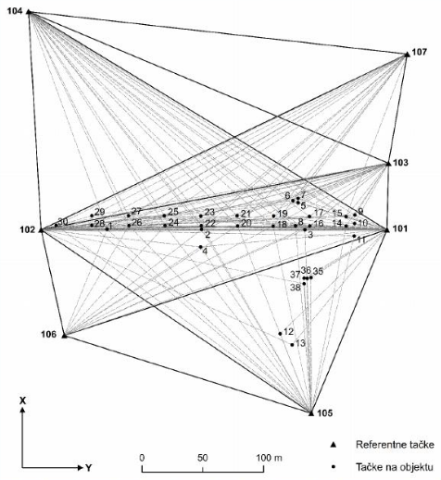
Network of static baselines
3-4mm horizontal accuracy, 5-7mm vertical accuracy
Require more baselines than unknown point
LSA provide quantity and quality evaluation
Several gnss must be on stable locations
Daily results within same coordinate system build time series

Slide 8
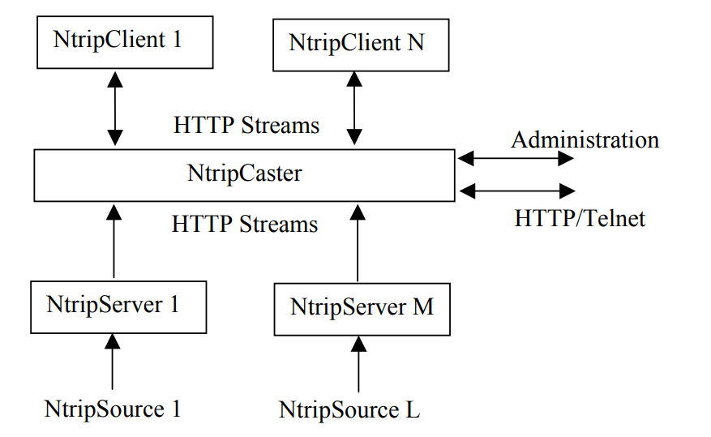
Node network and connectivity
NTRIP protocol
Protocol for streaming GNSS data over the internet. NTRIP protocol is based on Hypertext Transfer Protocol HTTP/1.1
NTRIP is agnostic and can be used for other sensors
NTRIP has 3 components (client, server and caster)

Slide 9
GeoSolutions solutions
GNSS CORS network
GNSS CORS stations
GSCaster2
Analytics

Slide 10
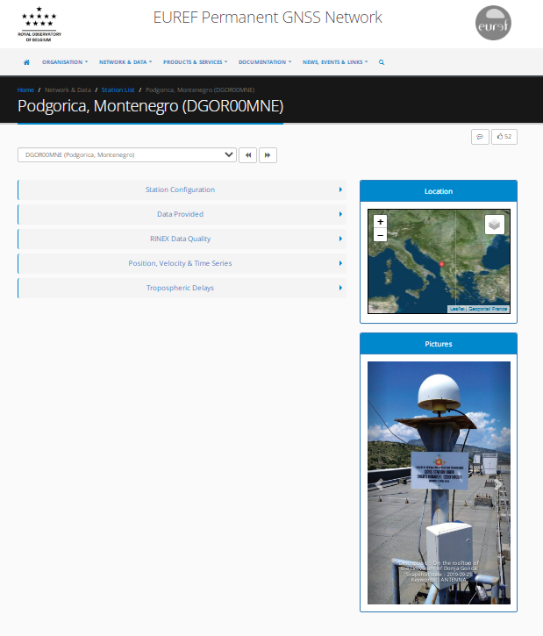
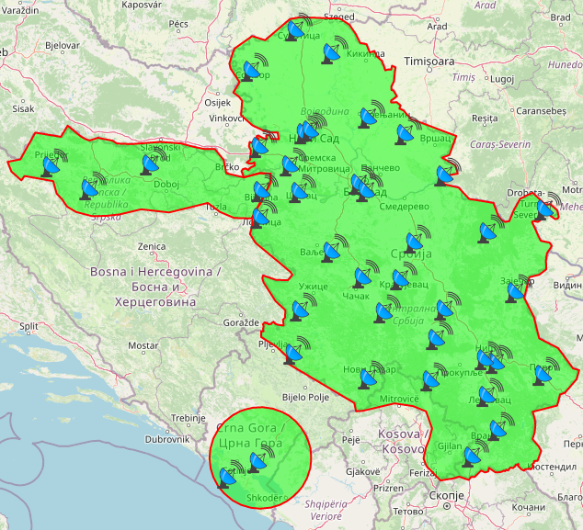
GeoSolutions solutions Regional CORS network
45 CORS stations
>250 Clients

Slide 11
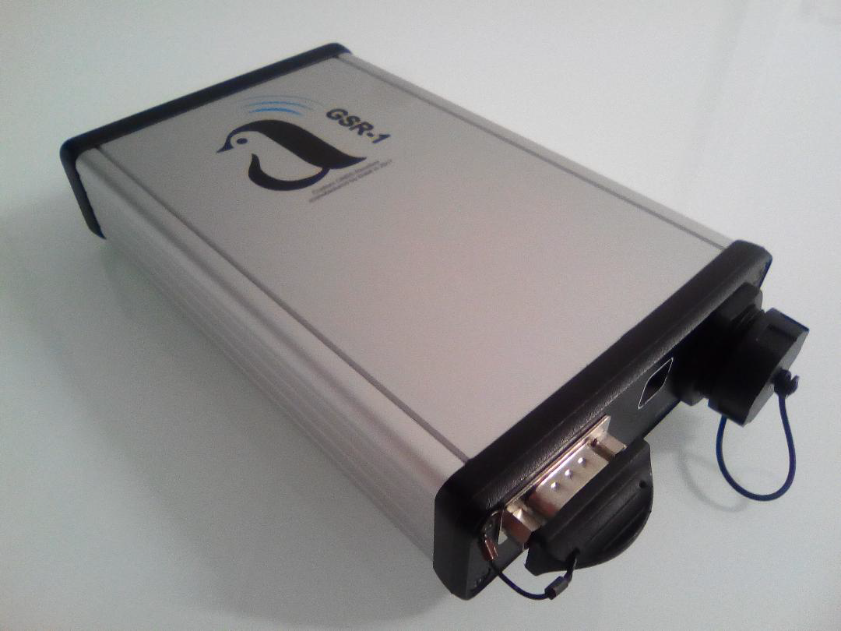
GeoSolutions solutions CORS station
gps+glo+bei+gal
3 frequencies
5V
RJ45, WIFI, serial
RTCM and ASCII output
Ntrip client/server
Modular

Slide 12
GeoSolutions solutions GSCaster2
Specifications
Written in C programming language
GNSS data broadcast in real-time over the Internet using the ntrip dissemination technique
Running on LINUX (tested for various distributions, such as SuSE, Debian, Gentoo, Redhat)
Supporting ntrip versions 1 and 2
Logging RINEX files or check their quality;
Decoding RTCM Version 3 'Multiple Signal Messages' (MSM) and 'High Precision Multiple Signal Messages' (HP MSM) including X-type observations for GPS, GLONASS and Galileo;
Easy installation and configuration based on a low number of configuration files
Tested for more than 100 data streams and more than 2000 simultaneous users

Slide 13
GeoSolutions solutions Analytics
RTK, PPK, Network adjustment, PPP
Internet communication
IoT networks

Slide 14
GentooARS – GeoSolutions core business
http://geosolutions.co.rs:2101/admin

